Slide 1
Systems and Application Security

Slide 2
Identify and Analyze Malicious Code and Activity

Slide 3
Malicious Code
Malicious code (sometimes called malware) is a type of software designed to take over or damage a computer's operating system without the user's knowledge or approval

Slide 4
Example Worms
I Love You (2000)
Slammer (2003)
Nimda (2001)
Morris (1988)

Slide 5
Windows Rootkit
Persistent-mode rootkits
Memory-based rootkits
User-mode rootkits
Kernel-mode rootkits

Slide 6
Adware, Spyware, and Potentially Unwanted Programs
Adware
Spyware
Rogue software

Slide 7
Polymorphic Viruses
Polymorphic viruses assume many (poly) shapes and forms (morphic) by encrypting code differently with each infection

Slide 8
Proof of Concept
Functional code that can be used to validate that an exploit actually works and to detail the specifics of how it functions

Slide 9
Polymorphism and Virus Creation Kits
Virus creation kits
Virus Creation Lab

Slide 10
Hacktivism Moving Toward Cyberwar and Cyberterrorism?
Cyberwar
Cyberterrorism
Hacktivism

Slide 11
Malicious Code Countermeasures
At the gateway
At workstations that access information services

Slide 12
Malicious Code Detection System Requirements
Allow access to all services available on the WAN
Be able to locate the source and type of an infection
Be able to react to such intrusions
Be able to fully reconstitute the system following intrusions
Have minimal operational effect on the user
Have minimal operational effect on performance

Slide 13
Malicious Code Detection System Requirements
Have appropriate documentation
Allow automatic malicious code prevention programs to run in the background
Allow a disaster recovery plan to recover data
Provide adequate scanning tools
Have appropriate means to trace all incoming and outgoing data
If Internet is unavailable, be able to access to virus updates

Slide 14
Malicious Code Detection System Requirements
Monitor usage as required by the administrator
Scan for malicious software at the enclave boundary and workstations
Log and analyze source-routed and other packets
Allow a rapid disconnect from the network

Slide 15
Configuration/Management Requirements
Be updated with regard to relevant security issues
Be configured by the administrator to filter all incoming data
Allow the administrator to automatically create policy for network usage
Allow regular backups of all system data
Provide adequate controls
Be capable of setting additional passwords

Slide 16
Configuration/Management Requirements
Be capable of placing restrictions on types of commands used on networks
Deny access to system manager accounts from network ports
Monitor usage of the network during odd hours
Provide no more than one administrator account

Slide 17
Countermeasures for Malware
Antivirus software on user machines
Install and use several different antivirus software
User awareness training
Disable scripts when previewing or viewing e-mail
Block attachments at network borders
Prevent download of software from the Internet
Strict software installation policies
Block the use of removable drives
Antivirus scanners on e-mail gateways

Slide 18
Software Exploitation Methods
Backdoor
Buffer overflow attack
Pointer overflow attack
Directory traversal
Covert channels

Slide 19
Behavior-Blocking Software
Integrates with the operating system of a host computer and monitors program behavior in real time for malicious actions

Slide 20
Code Signing
A digital signature serves as a means of confirming the authenticity of an object, its origin, and its integrity

Slide 21
Sandboxing
A secluded environment on a computer where you can run untested code or malware to study the results without having any ill effects on the rest of your software

Slide 22
Static Analysis
Static source code analyzers attempt to ﬁnd code sequences that, when executed, could result in buffer overﬂows, resource leaks, or many other security and reliability problems

Slide 23
Security Awareness Training
Never trust unsolicited e-mails, instant messages, or other communications
Situational-specific awareness based on their roles and responsibilities

Slide 24
Long File Extensions
On Windows NTFS-based operating systems, the filename can be up to 255 characters long
Filenames that are very long are abbreviated with three dots “...” concealing the true extension of the file

Slide 25
Double File Extensions
The use of double file extensions is often combined with long filenames to show only the first extension, such as:
“Madonna.jpg”
followed by many spaces and then the real extension, such as .exe:
“Madonna.jpg.exe”

Slide 26
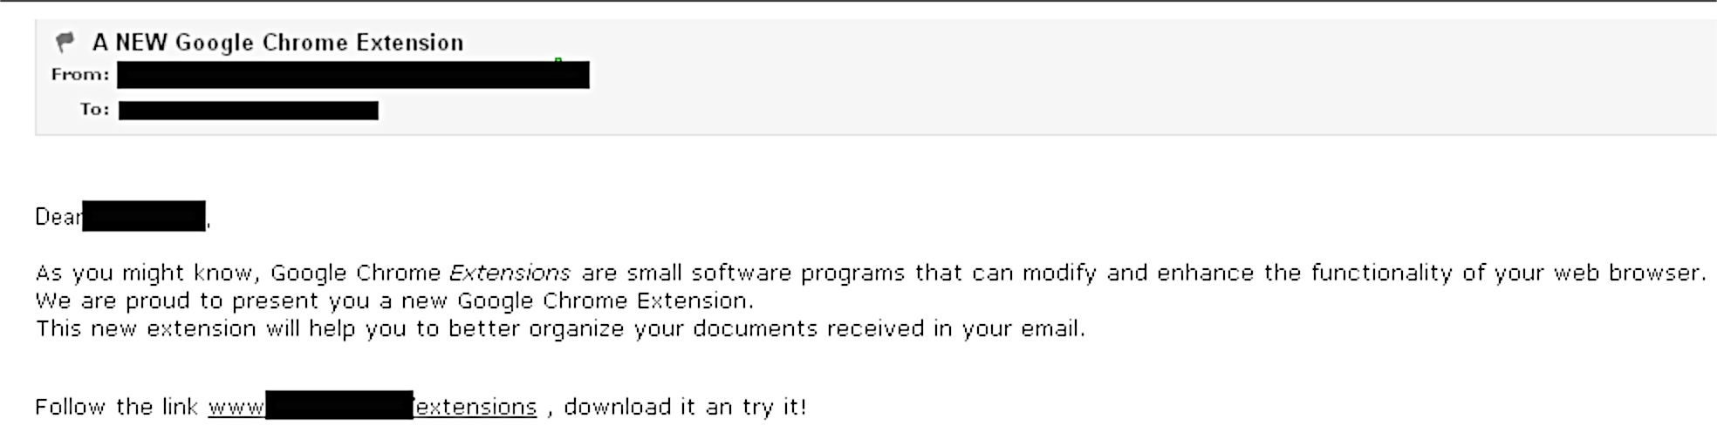
E-mail
One of the most well-known vectors for spreading malcode

Slide 27
Insider Threats
Authorized access to an organization's network
Intentionally misuse
Negatively affect confidentiality, integrity, or availability

Slide 28
Indicators of Malicious Threat Activity
Remotely accesses the network while on vacation, sick, or at odd times
Works odd hours without authorization
Notable enthusiasm for overtime, weekend, or unusual work schedules
Unnecessarily copies material
Interest in matters outside of the scope of duties
Signs of vulnerability

Slide 29
Countermeasures
Train employees to recognize threats
Conduct training on risk perception and cognitive biases
Improve usability of security tools and software
Enhance awareness of unintentional insider threat
Provide effective security practices
Maintain staff values and attitudes that align with organizational mission and ethics

Slide 30
Detection, Prevention, and Deterrence Methods
Data/file encryption
Data access monitoring
SIEM or other log analysis
DLP
Data redaction
IAM
Data access control
IDS/IPS

Slide 31
Insider Hardware Threats
Monitor phone activity logs
Monitor and control privileged accounts
Monitor and control external access
Protect critical files
Disable accounts upon employee termination
Prevent unauthorized removable storage mediums
Identify all access paths

Slide 32
Spoofing
A situation in which one person or program successfully masquerades as another by falsifying data and thereby gaining an illegitimate advantage

Slide 33
Phishing
The attempt to acquire sensitive information such as usernames, passwords, and credit card details by masquerading as a trustworthy entity in an electronic communication

Slide 34
Common Characteristics of Forged E-Mail Messages
Use of the names of existing companies
Use of the name of a real company employee
Web addresses that seem to be correct
Fear factor

Slide 35
Techniques
Man-in-the-middle
Exploitation of cross-site scripting vulnerabilities in a website
Vulnerabilities in Internet Explorer
Exploits hosted in malicious websites

Slide 36
Protecting Users From Spam
Do not publish personal e-mail addresses
Never click on the “unsubscribe” link in spam
Never reply to a spam message
Do not resend chain letters
Do not open the spam message
Disable the Preview Pane of the e-mail client

Slide 37
Protecting Users From Spam
Do not purchase products from unsolicited e-mails
Have e-mail accounts for separate purposes
Use an anti-spam filter or an anti-spam solution
Install an antivirus solution
Install content filter software

Slide 38
Botnets
A botnet is an army of compromised machines, also known as "zombies," that are under the command and control of a single "botmaster”

Slide 39
Botnet-Led Exploits
DDoS Attacks
Spyware and Malware
Identity Theft
Adware
E-mail Spam
Click Fraud
Phishing

Slide 40
Botnet Detection and Mitigation
Botnets use multiple attack vectors; no single technology can provide protection against them

Slide 41
Common Botnet Detection and Mitigation Techniques
Flow data monitoring
Anomaly detection
DNS log analysis
Honeypots

Slide 42
Cross-Site Scripting (XSS) Attacks
Hacking technique that leverages vulnerabilities in the code of a web application to allow an attacker to send malicious content from an end user and collect some type of data from the victim

Slide 43
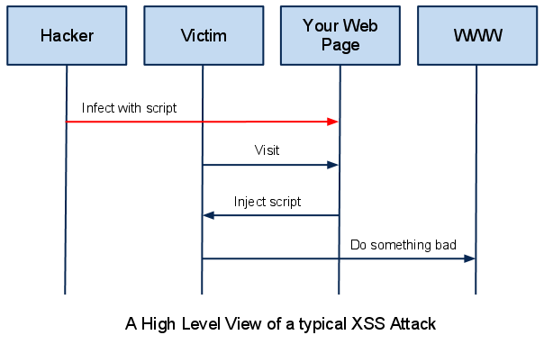
The Theory of XSS

Slide 44
Example of a Cross-Site Scripting Attack
Search Results for "XSS Vulnerability”
Next, try to send the following query to the search engine
Upon loading the results page, the test search engine would probably display no results for the search, but it will display a JavaScript alert that was injected into the page by using the XSS vulnerability

Slide 45
How to Check for Cross-Site Scripting Vulnerabilities
Web Vulnerability Scanner:
Automatically checks for cross-site scripting vulnerabilities
Indicates which URLs/scripts are vulnerable to these attacks

Slide 46
Zero-Day Exploits and Advanced Persistent Threats (APTs)
An attack that exploits a previously unknown vulnerability in a computer application or operating system, one that developers have not had time to address and patch

Slide 47
Five Phases of an APT
Reconnaissance
Incursion
Discovery
Capture
Exfiltration

Slide 48
Instant Messaging
Instant messaging (IM) threats may involve exploitation of software to spread code but more frequently rely on social engineering

Slide 49
Peer-to-Peer Networks
Peer-to-peer (P2P) networks involve hosts sharing files with one another, either directly or through a centralized P2P server

Slide 50
Internet Relay Chat (IRC)
Big part of how people “chatted” or communicated near the turn of the century
Today, social networking sites and forums are dominating the scene as IRC falls into the background

Slide 51
Rogue Products and Search Engines
There are literally hundreds of rogue security products:
Antivirus XP 2008/9
Antivirus Pro
Others

Slide 52
Backdoor Trojans
Collect information
Terminate tasks and processes
Run tasks and processes
Download additional files
Upload files and other content
Report on status
Open remote command line shells
Denial-of-service attacks
Change computer settings
Shut down or restart the computer

Slide 53
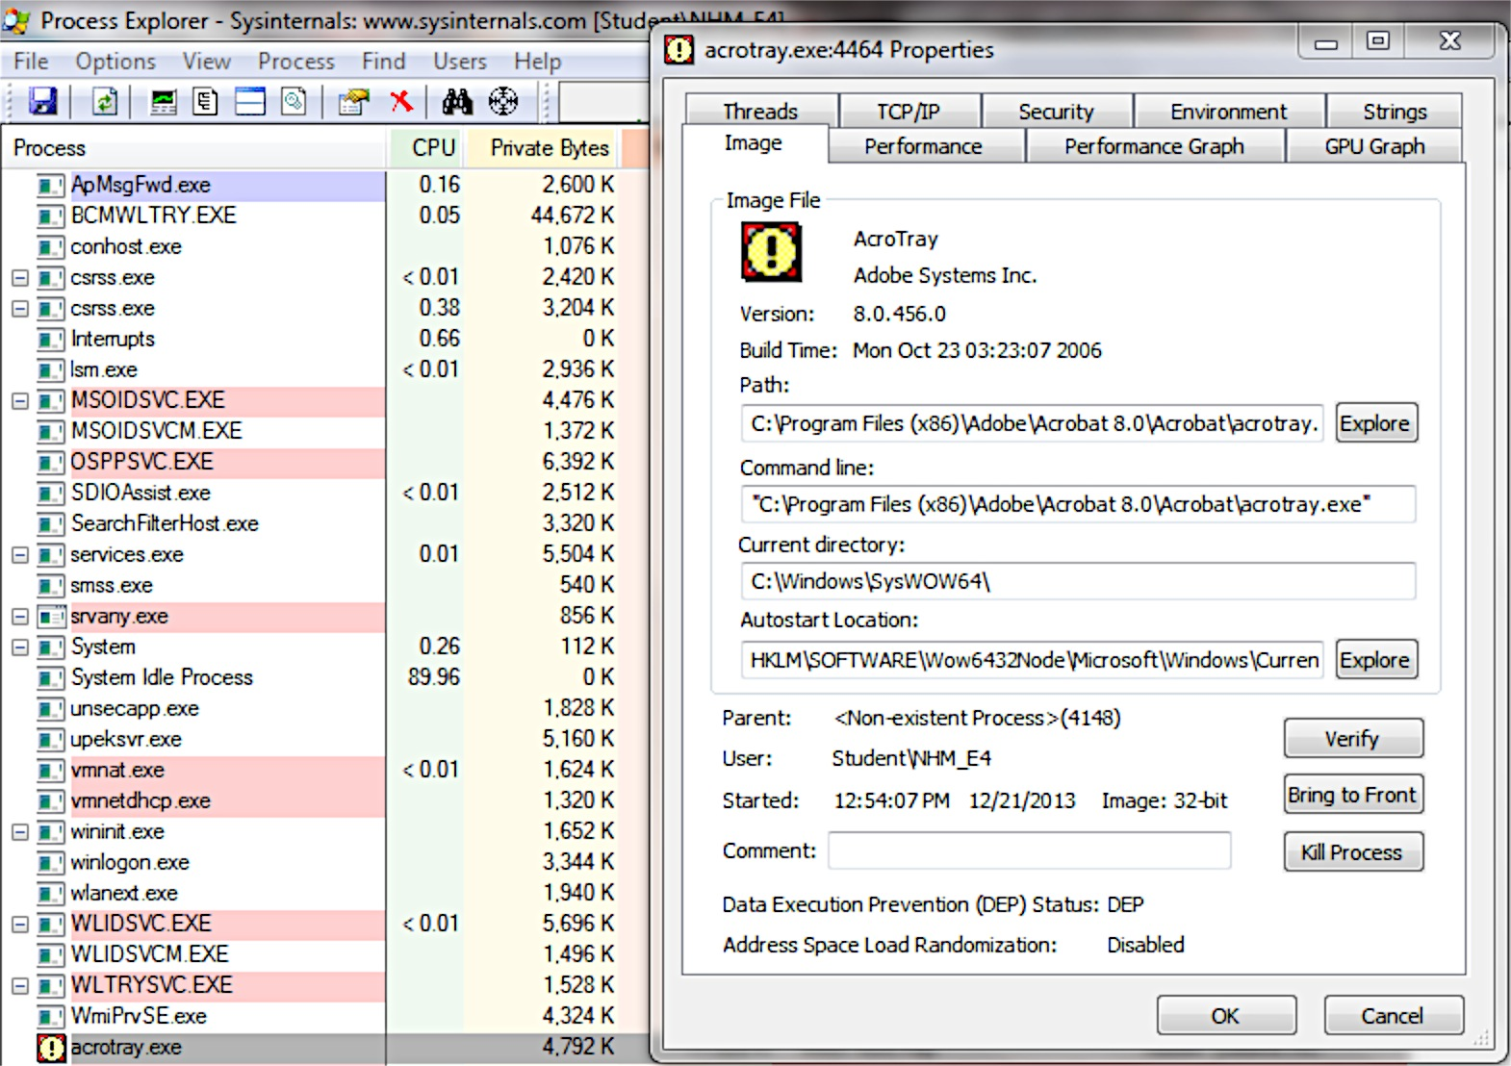
Process Explorer

Slide 54
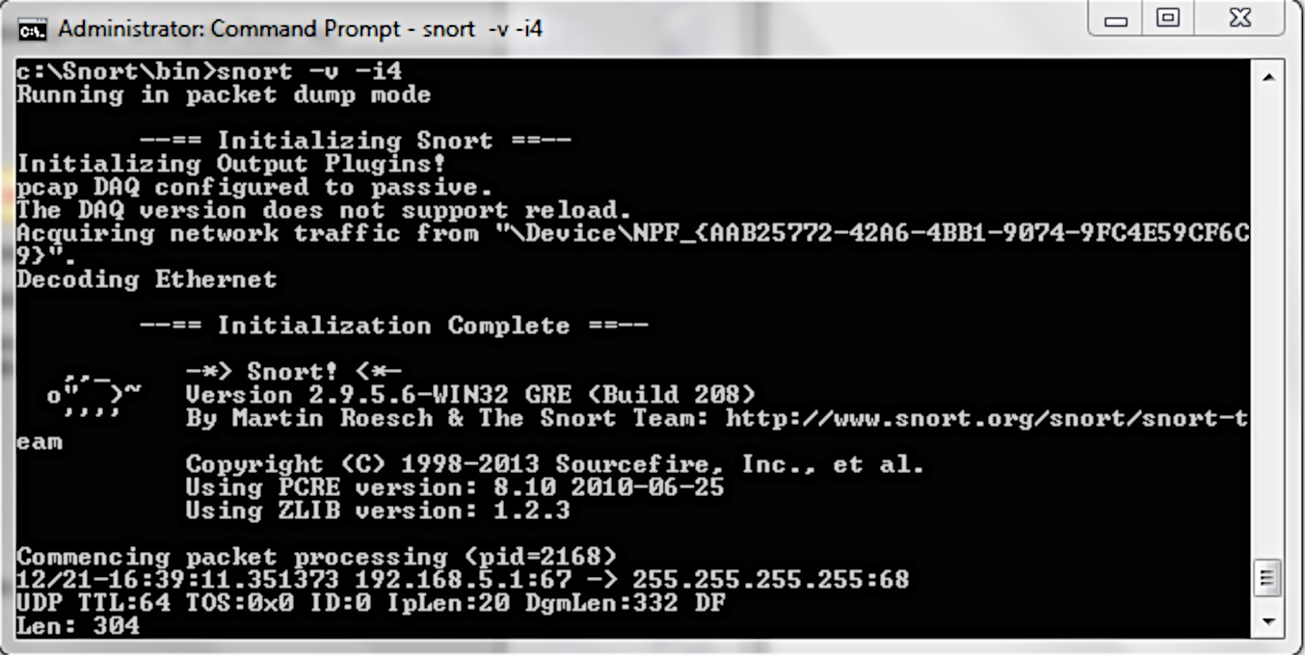
SNORT

Slide 55
Application Layer
Signature Detection
Heuristic Analysis

Slide 56
Heuristics
File Emulation
File Analysis
Genetic Signature Detection

Slide 57
Third-Party Certifications
Identify solutions that provide centralized management
Consider demonstrations of products
Look for consistency in certifications

Slide 58
Modified Hosts File and DNS Changes
Malicious code may modify the hosts file to block or redirect traffic on the host
Normally has just a few entries
If it has additional entries that point to questionable content or loopback, it may indicate a malicious code infection

Slide 59
Inspection of Processes
Look for new processes taking up lots of memory
Find a new or unexpected process in the list of running processes
Process Explorer

Slide 60
Inspection of the Windows Registry
The Windows registry includes the following four keys:
HKEY_LOCAL_MACHINE\Software\Microsoft\Windows\CurrentVersion\Run
HKEY_CURRENT_USER\Software\Microsoft\Windows\CurrentVersion\Run
HKEY_LOCAL_MACHINE\Software\Microsoft\Windows\CurrentVersion\RunOnce
HKEY_CURRENT_USER\Software\Microsoft\Windows\CurrentVersion\RunOnce

Slide 61
Rootkit Classifications
Persistent rootkits
Memory-based rootkits
User-mode rootkits

Slide 62
Kernel-Mode Rootkits
Kernel-mode rootkits can be even more powerful since:
Can intercept the native API in kernel mode
Can also directly manipulate kernel-mode data structures

Slide 63
Behavioral Analysis of Malcode
A test system must be in place to properly analyze malcode behavior
This should contain a known set of applications, processes, and tools that establish a behavioral baseline
Changes to the system can then be identified

Slide 64
File Properties
File properties can be useful in correlating a sample to related samples or data on malcode of interest
Exact details about the file may help identify other computers infected with a different filename but similar file size or modified or created time values

Slide 65
Hash
Hash values are a cryptographic function used to calculate a unique value for a file
Even a minor change in 1 byte of a file results in a new hash value

Slide 66
Portable Executables Header
Portable Executables (PE files) for Windows 32- and 64-bit systems have a header that can tell much about the file

Slide 67
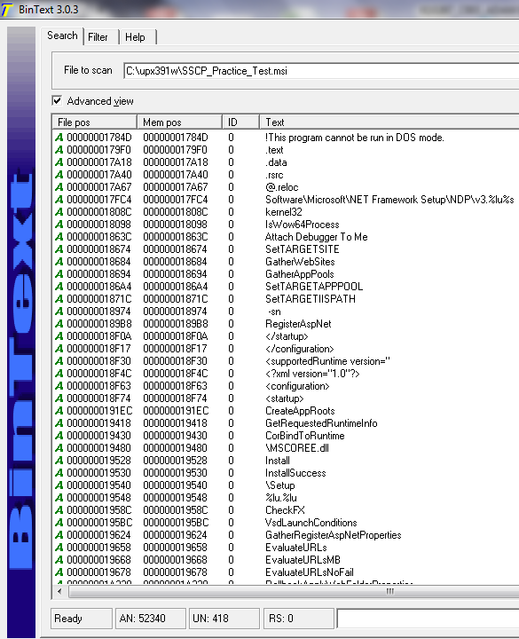
String Analysis

Slide 68
Unpacking Files
Unpacking files first involves trying to identify what program or tool the code was packed with

Slide 69
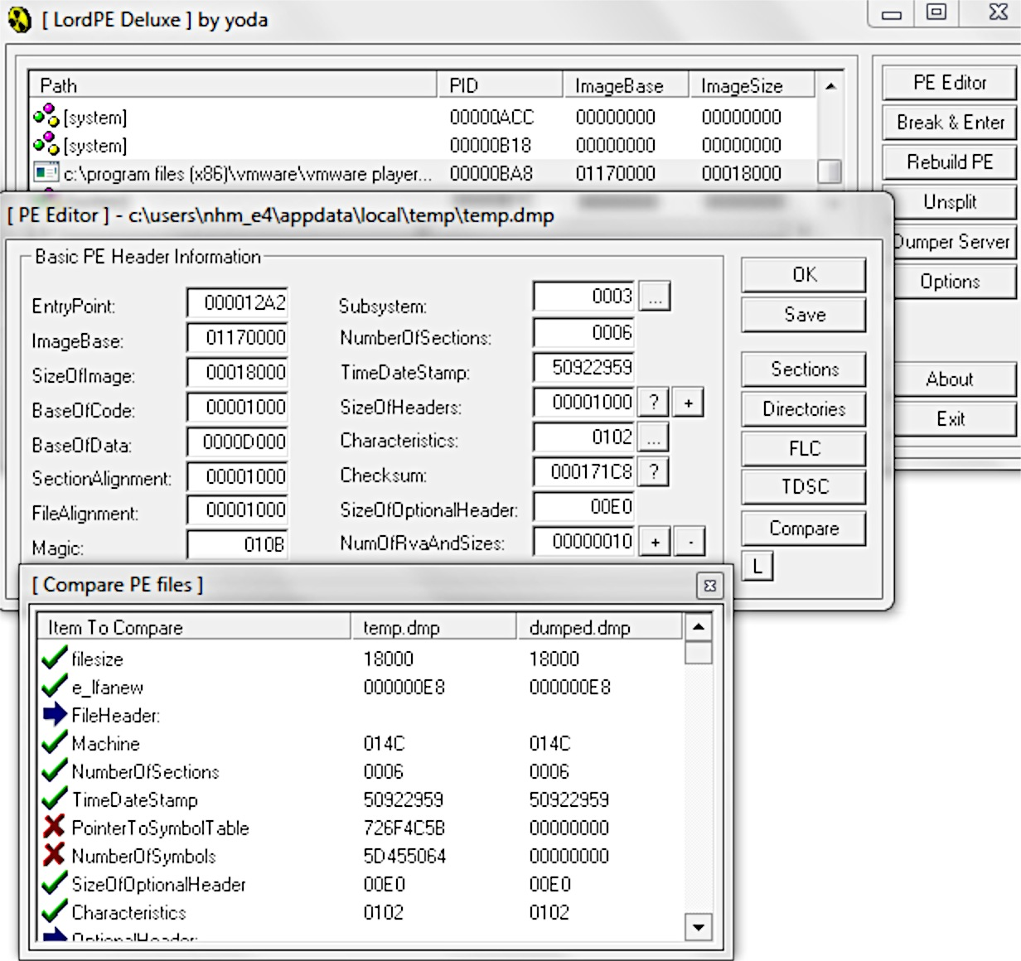
Memory Dumps

Slide 70
Testing Remote Websites Found in Network Log Files
Log files from firewalls, IDS, IPS, Snort, and others are often configured to only report the basic fact
Often leaves out important information such as the exact path or domain visited by a victim during an attack

Slide 71
Passive DNS Queries
Passive DNS databases can answer questions that are difficult or impossible to answer with the standard DNS protocol, such as:
Where did this domain name point to in the past?
What domain names are hosted by a given nameserver?
What domain names point into a given IP network?
What subdomains exist below a certain domain name?

Slide 72
Proxy Tools
Proxify
Anonymouse
Anonymizer
Ninja Cloak
Firefox, Adobe Acrobat Reader
OllyDbg with OllyScript

Slide 73
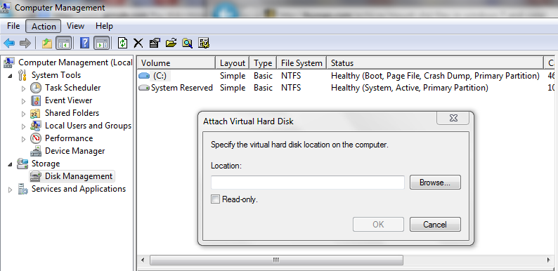
Advanced File Capture Techniques

Slide 74
Additional Methods
Suspend Memory Captures
Linux DD Captures
Anti-VMware Code Techniques

Slide 75
Tactical
Harden systems against attack, including:
Operating system
Application updates
Antivirus updates
Properly back and protect data

Slide 76
Common Mistakes
Never remotely log in to a potentially infected computer with an account that has administrative rights
Always strive to find the root cause of the problem that is being addressed
Do not rely on antivirus solutions to solve all problems
After a malcode incident, put special alerts in place
When working with file-infecting viruses that also have worm components, recognize the challenge

Slide 77
Common Mistakes
Forget about manual disinfection after a malcode outbreak unless it is a short-term fix on a computer that cannot be taken offline immediately
Realize that safe mode can be undermined by some malcode
Audit everything to know what is going on inside and in and out of a network at all times
Maximize intelligence load balancing, bandwidth, and upstream host provider anti-DDoS capabilities or throttling and tarpitting techniques

Slide 78
Common Mistakes
Configure routers within internal networks to explicitly limit ingress traffic to allow only IP addresses that are on a whitelist
Configure routers to block spoofed traffic from within a network
Consider using a honeypot to trap bot traffic, analyze it, and ensure countermeasures and auditing is in place

